Slide 1
Led SIGNAGE PROPOSAL for (CUSTOMER NAME OR LOGO)
Insert Your Logo Here

Slide 2
Project Details

Slide 3
About Us (sign company)

Slide 4
Why ThinkSIGN?
Trusted.
With hundreds of sign partners nationally, we have a proven ability to preserve your trust in us. And, our products are top notch. Our entire system is UL listed and FCC Verified with a five year warranty. ThinkSIGN only employs the very best LEDs, components, and hardware for our EMCs.
Easy.
Easy to sell, to install, use and even service. Our signs deliver ready to install. A 2” C-channel frame of 3/16” galvanized and powder coated steel won’t rust and offers unlimited mounting options. Hook it, hang it, and have it ready to display in no time. And, our proprietary Smart LED Manager Pro Software requires no training, but just in case, we provide online tutorials and Wednesday Webinars with our stellar tech support
staff.
Fast.
We have the ability to design, build and deliver in two weeks! Our proprietary modular design makes assembly much faster. When you place an order, we build, test, package and deliver in as little as 2 weeks. Others can take up to 4X longer.

Slide 5
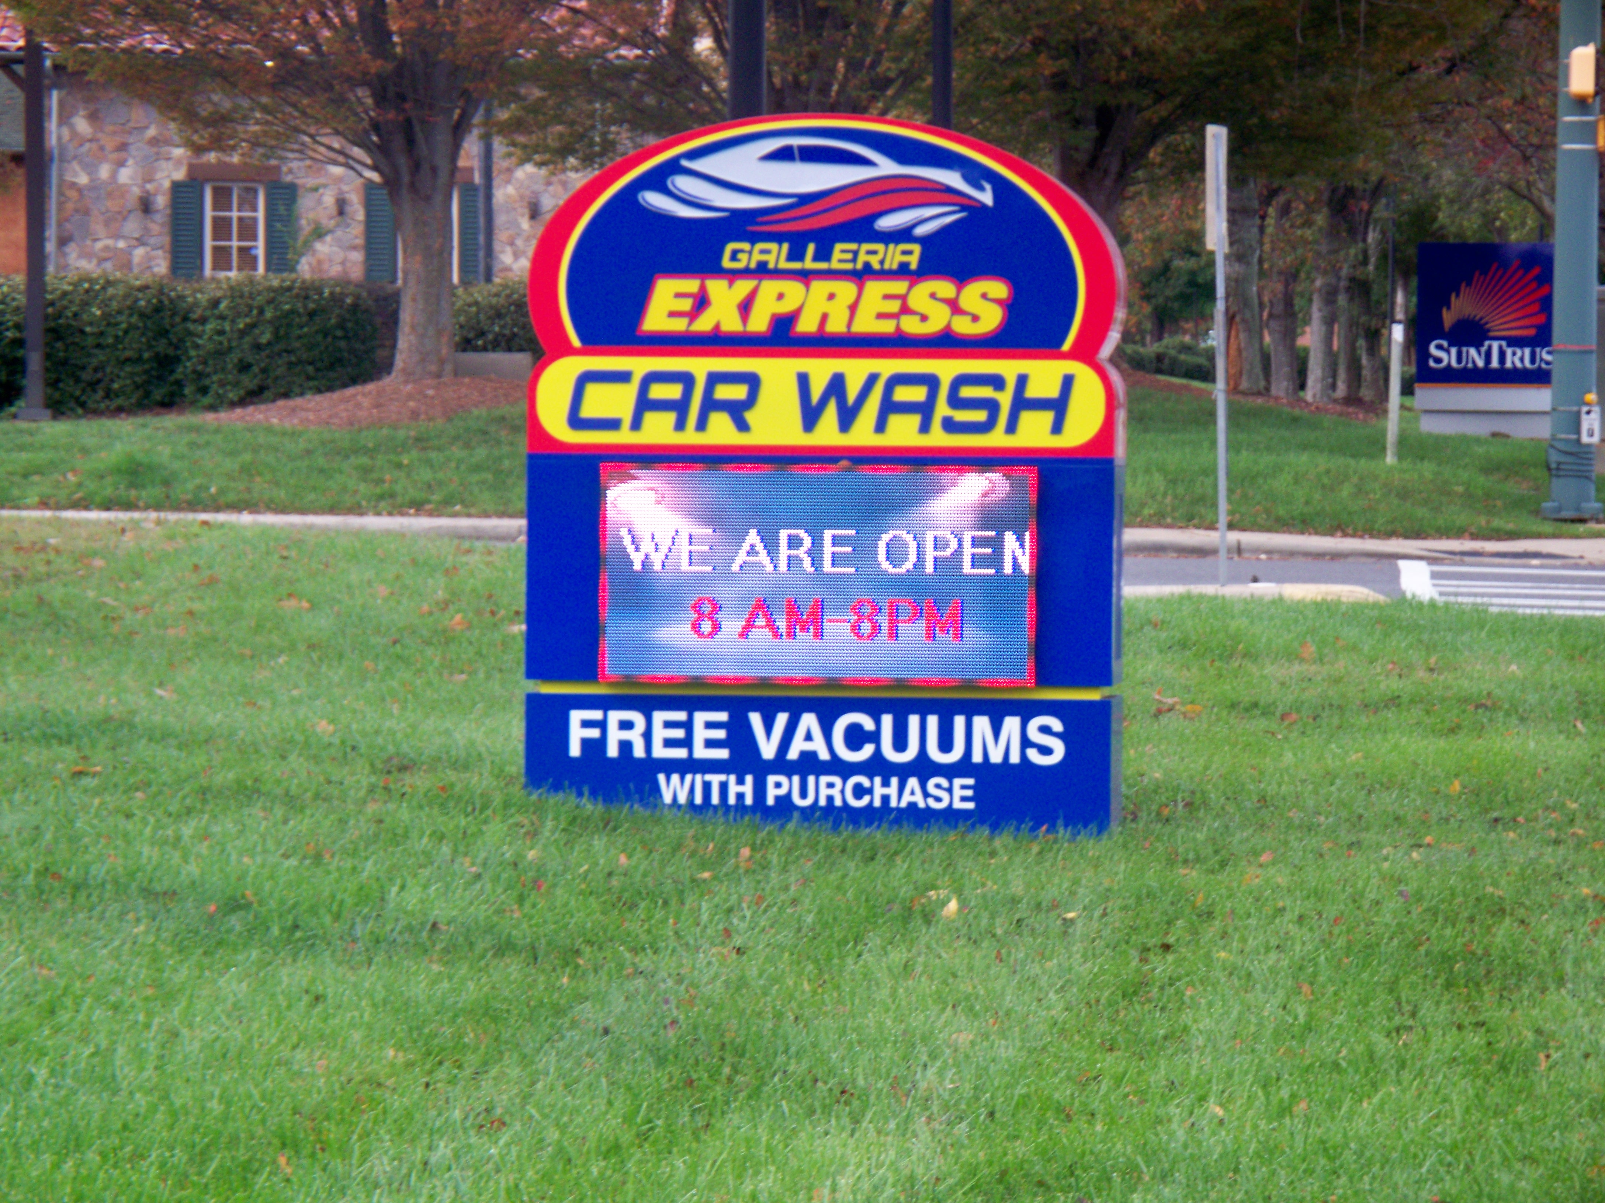
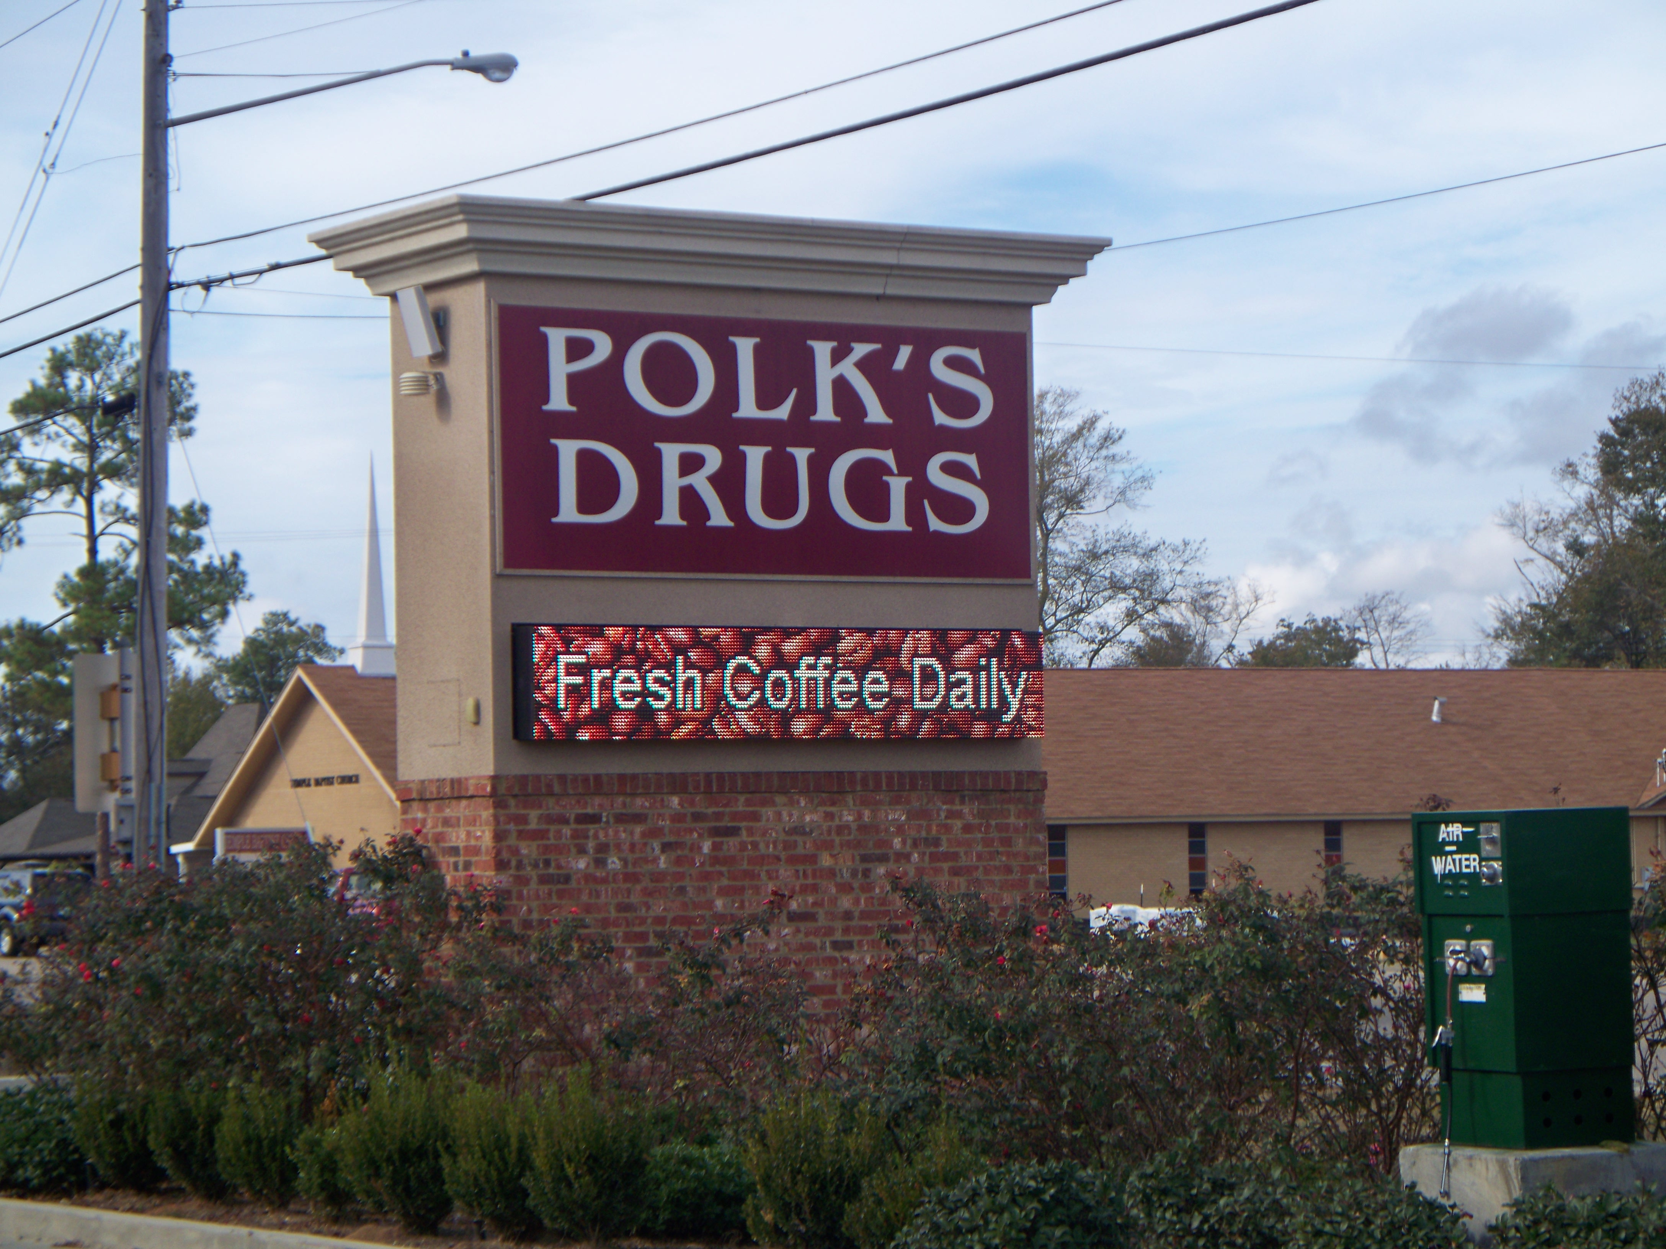
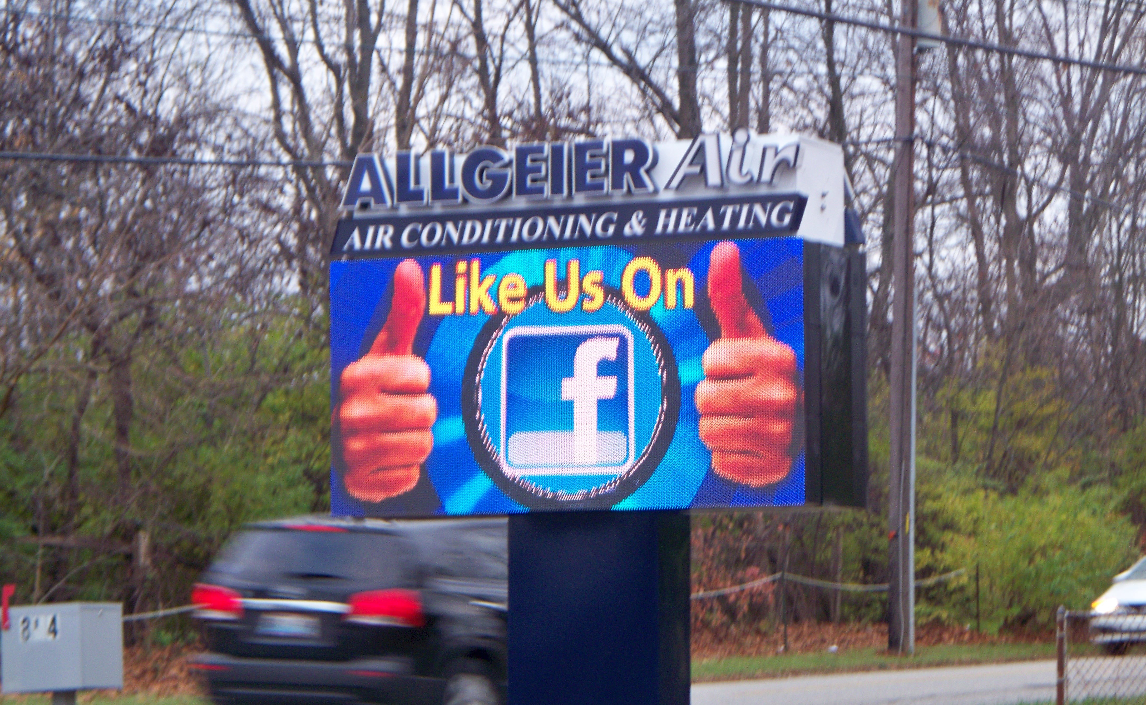
About ThinkSIGN EMCs
ThinkSIGN Xtreme is our full color product family. Our Xtreme product is Thinner, Lighter & Smarter. The best on-premise message center on the market. A borderless design to maximize allowed square footage and universal module that makes installs, retrofits and upgrades a breeze.
COULD SHOW RELEVENT EXAMPLES HERE BASED ON PROJECT

Slide 6
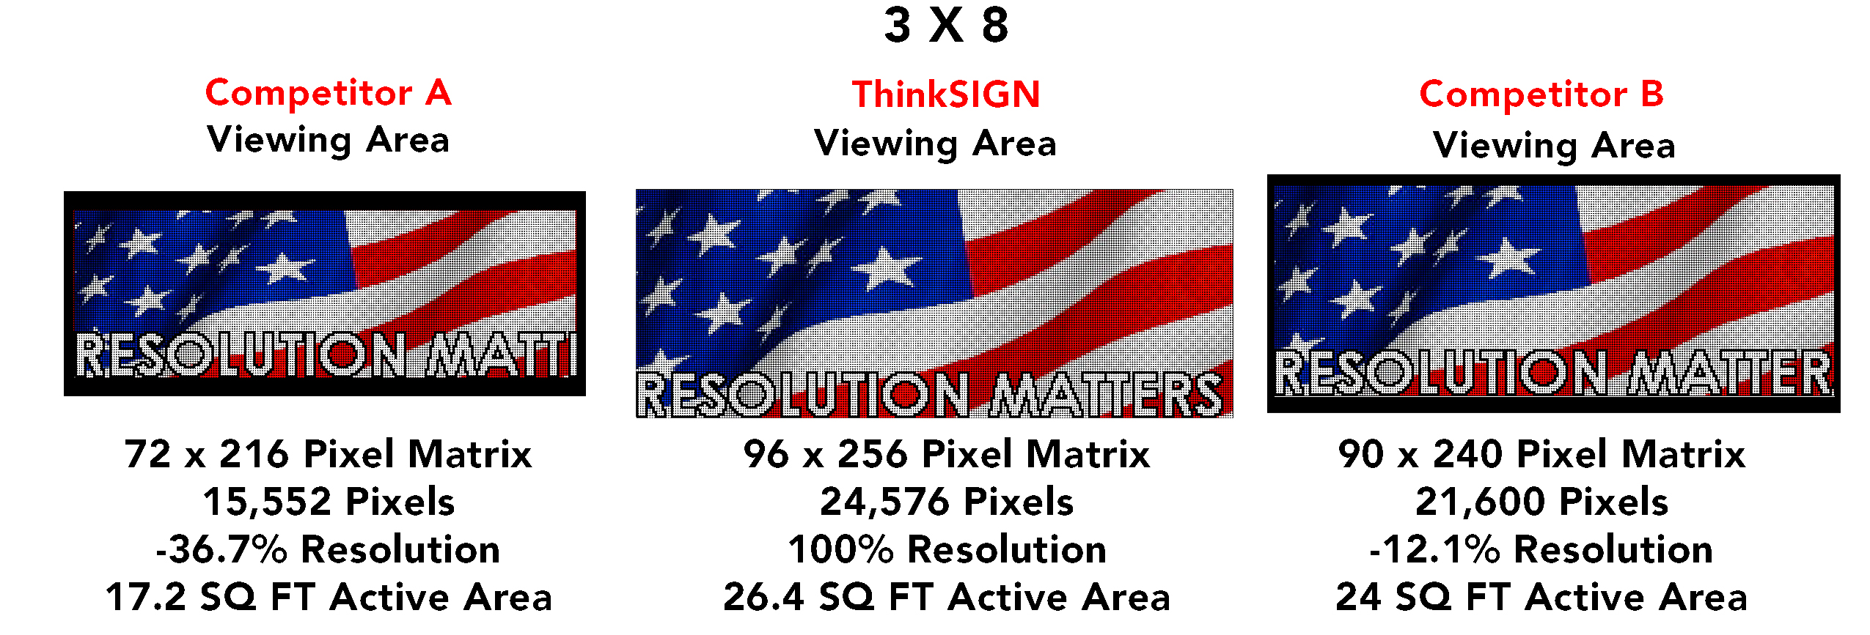
Borderless Design
ThinkSIGN’s borderless Xtreme, when compared to other brands,
maximizes your allowable square footage resulting in MORE pixels and resolution. The image below shows a side by side comparison with two of the leading brands.
COULD SHOW RELEVENT EXAMPLES HERE BASED ON PROJECT

Slide 7
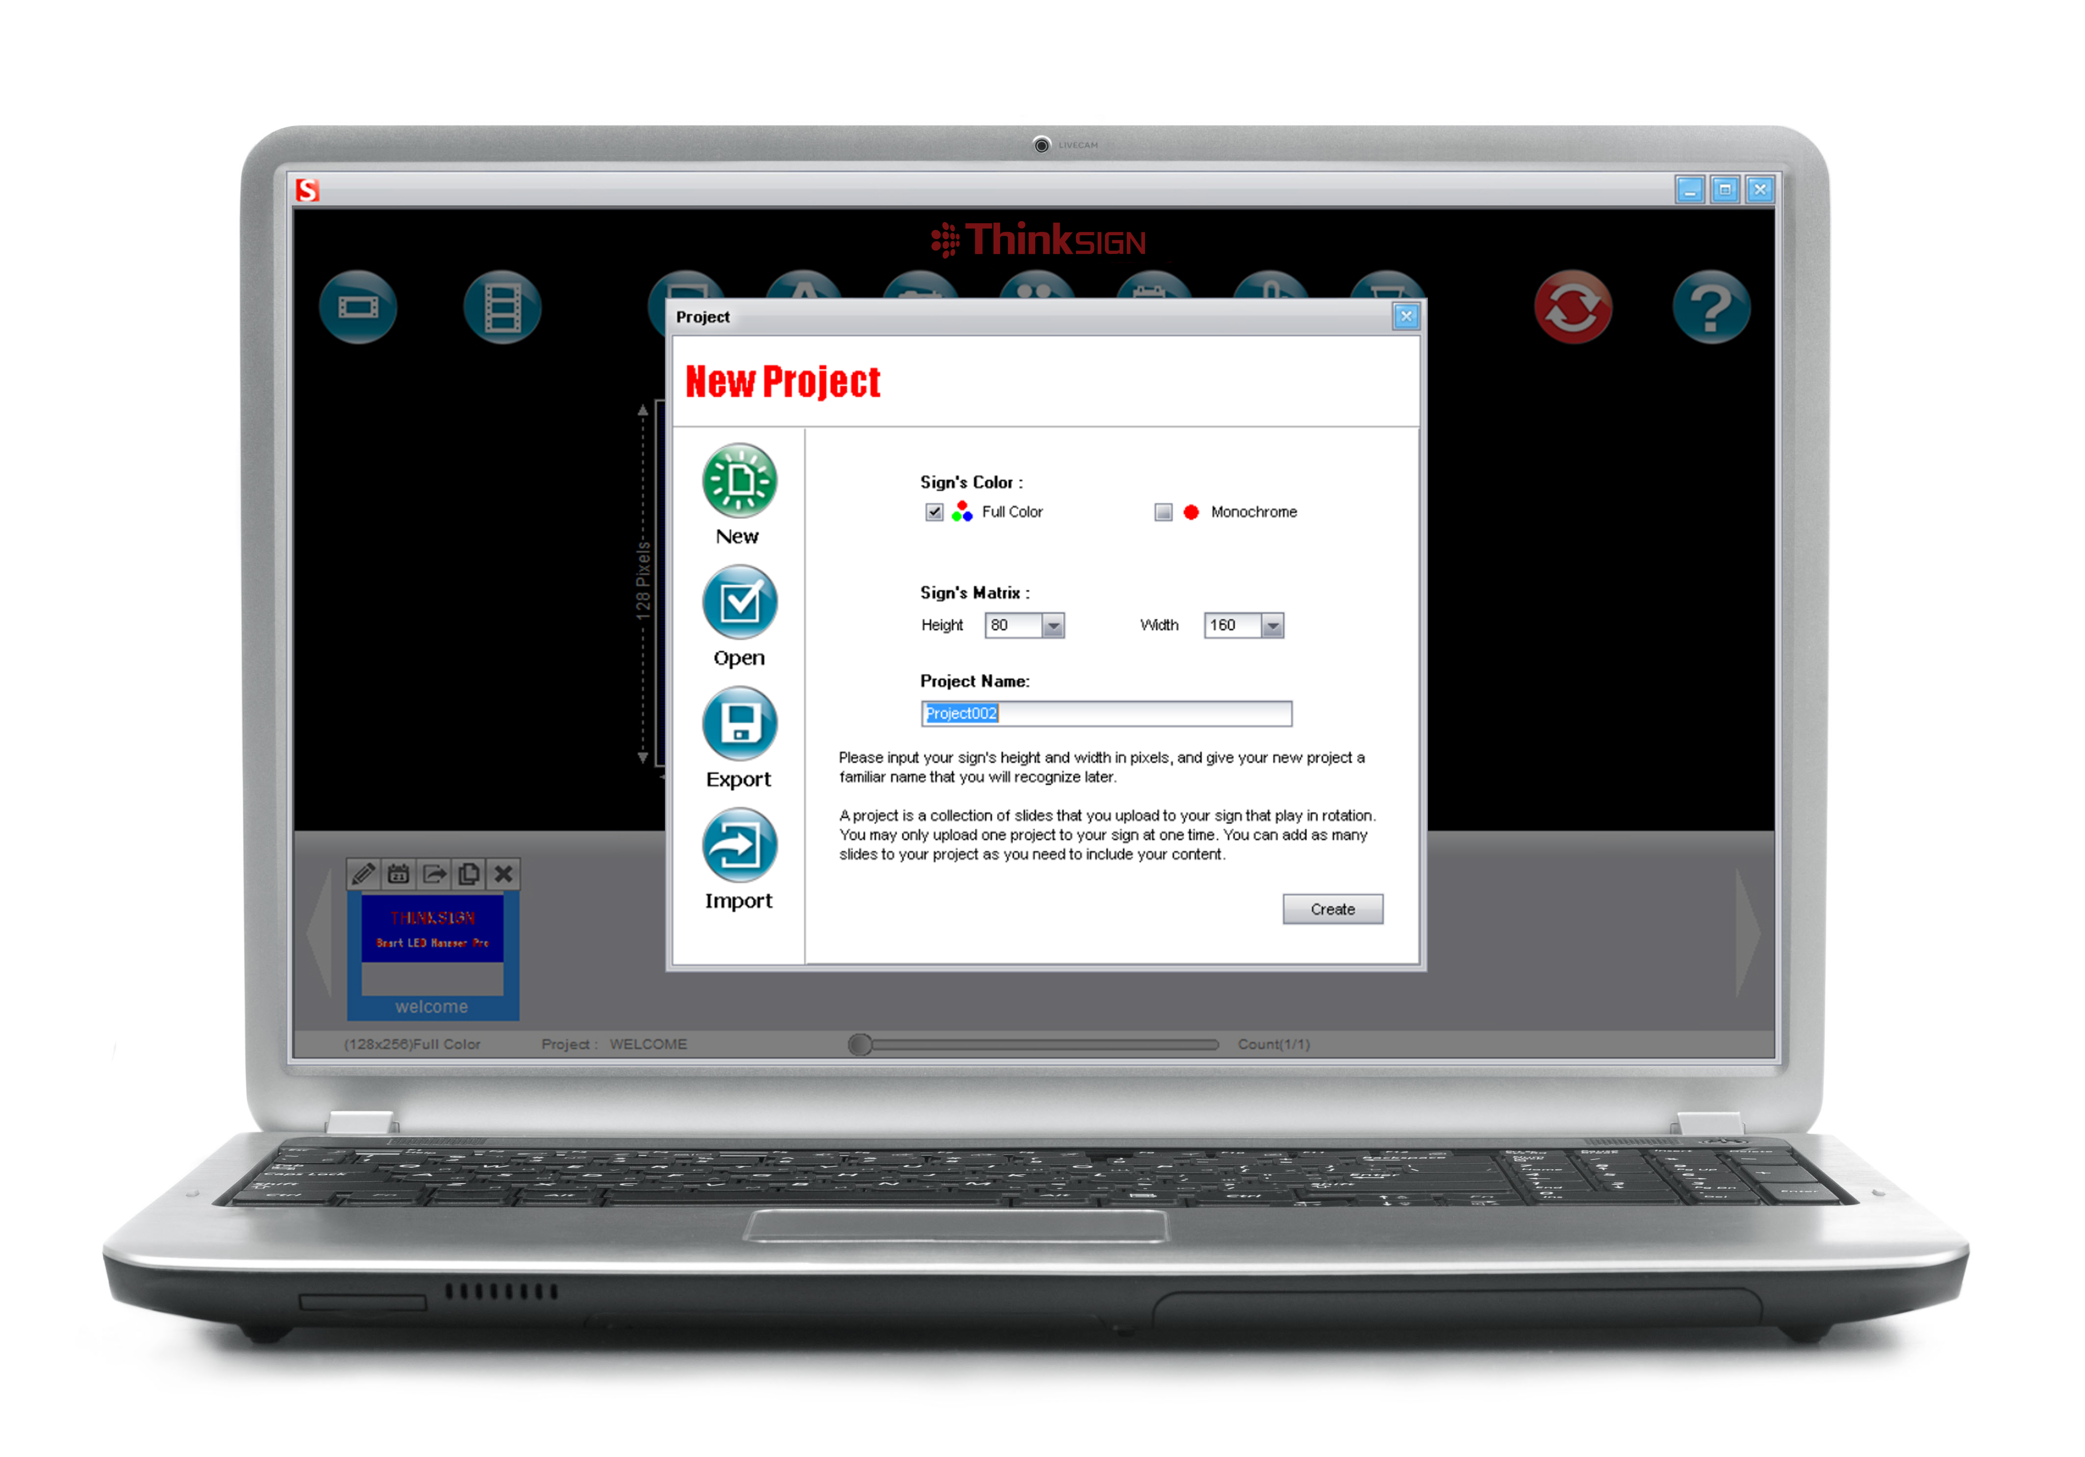
ThinkSIGN Software
Unique scheduling features; including auto on/off
Count up and count down functionality
Write or edit text in seconds
Import photos and add text easily
Upload and manage videos
Vast image and animation library included
Online tutorials and tech support training
Custom Content Solutions available

Slide 8
Project Rendering

Slide 9
Project Estimate

Slide 10
Summary

